Slide 1
Go-Live Preparations
Workday@Yale
May 4, 2017
Financial Management
Workday@Yale
May 4, 2017

Slide 2
Agenda
Overview
Cutover Plan
Preparing for Go-Live
Training
What’s Next

Slide 3
Overview
Workday@Yale

Slide 4
Workday@Yale Objectives
Simplify and standardize processes
Make it easier to get work done
and harder
to make mistakes
Minimize administrative work for faculty, students and staff
Lower operating costs and improve effectiveness
Provide accurate, trusted,
and timely reporting

Slide 5
Meeting the evolving needs of higher education.
Workday integrates financial, HR, academic, and research information to offer:
Frequent releases that optimize the system
Flexible reporting to meet changing needs
Mobile access and self-service – anytime, anywhere

Slide 6
Community and Communication Impacts
~250 Central Finance Groups
~6,600
Faculty, Postdocs, Fellows
~4,500 Managers and Professional Staff
~200 Lead Administrators and Operations Managers
~150 Service Teams
~100 Senior Leadership
~3,900
Clerical Workers and Technicians

Slide 7
Program Team
Workday@Yale Team Members
Service Group Members
162
66
Local Communication and Support Members
Support Center Staff
262
300+

Slide 8
Impacted Systems
Systems Critical for Go-Live 92
We are working to ensure that Workday information flows smoothly between existing systems such as the ID system, SciQuest, Facilities, etc.
Where necessary, we are making changes to those existing systems.
Other Systems 81
People Data Only 81
Financial and People Data 34
Financial Data Only 58

Slide 9
Timeline
2017
2018
Jan-Mar
Apr-Jun
Jul-Sept
Oct-Dec
Financials Go-Live
Training
User Testing
Post Go-Live Support (including YSS, ESC, ITS Help Desk)
Weekly Updates, Supervisor Updates, Information Sessions
Prepare for Go-Live
HR/Payroll/Academic Optimization
Financials Optimization
Notes:
Functionality updates occur, roughly, in March and September, as indicated by the “workday” logo.
We are communicating with users in a variety of ways: through our weekly update to LA’s, OM’s, Change Network, Executive Sponsors, Impacted Systems Community Members, and Workday Program Members. If this group isn’t receiving this communication, their supervisors/Change Partners are receiving it and will provide updates at their in-house meetings. Additionally, the Workday Program is hosting information sessions, like this one, to inform the community about upcoming changes.
We will be testing the system to ensure that the community can fulfill business processes in Workday (and to ensure our training materials are accurate and our support centers have adequate supporting documentation).
Post Go-Live support will be offered for 4 months after July 3, to ensure the community is prepared to use Workday.
We are actively preparing for go-live and will provide more detail in the months ahead.
Finally, we are continually optimizing and improving Workday, with input from the community. This is an ongoing process.

Slide 10
Cutover Plan
Workday@Yale

Slide 11
Cutoff Dates – Banking & Settlement
CURRENT STATE PROCESS | FUTURE STATE PROCESS | ORACLE/LEGACY CUTOFF DATE | WORKDAY START DATE
Petty cash - Treasury window disbursements | Petty cash - Treasury disbursements | 6/30/17 | 7/3/17
Petty cash replenishments for department funds | Petty cash replenishments for department funds | 6/19/17 | 7/5/17
RIF/Cash Receipts | Cash Sales | 6/30/17 | 7/5/17

Slide 12
Cutoff Dates – Financial Accounting
CURRENT STATE PROCESS | FUTURE STATE PROCESS | ORACLE/LEGACY CUTOFF DATE | WORKDAY START DATE
Journal Entries - ISPs and charges to departments other than your own | Journals | 7/14/17 | 7/5/17
Journal Entries - Non-Self-Support schools and all YSM departments | Journals | 7/21/17 | 7/5/17
Journal Entries - Self-Support schools incl. YSM central & Provost's Office | Journals | 7/28/17 | 7/5/17

Slide 13
Cutoff Dates - Payroll
CURRENT STATE PROCESS | FUTURE STATE PROCESS | ORACLE/LEGACY CUTOFF DATE | WORKDAY START DATE
LD Schedules - for FY18+ LD schedules | Cost Allocations & Position Restrictions | 6/23/17 | 7/5/17
LD Schedules - for June 2017 LD Schedules | Cost Allocations & Position Restrictions | 6/27/17 | N/A
Labor Distribution Adjustments (LDAs) | Payroll Accounting Adjustments | 7/21/17 | 7/5/17

Slide 14
Cutoff Dates – Business Assets
CURRENT STATE PROCESS | FUTURE STATE PROCESS | ORACLE/LEGACY CUTOFF DATE | WORKDAY START DATE
Moveable equipment inventory (MEI): Additions | Assets - MEI | 6/27/17 | 7/5/17
Moveable equipment inventory (MEI): Changes and Disposals | Assets - MEI | 6/21/17 | TBD

Slide 15
Cutoff Dates – Non-Sponsored Accounts Receivable (AR)
CURRENT STATE PROCESS | FUTURE STATE PROCESS | ORACLE/LEGACY CUTOFF DATE | WORKDAY START DATE
YSM BMS invoices, adjustments & write-offs | Customer Invoices | 6/30/17 | 7/5/17
YSM manual billings for clinical trials (non-BMS) – Last feed from Oncore | Customer Invoices | 6/30/17 | 7/5/17
YSM BMS payment posting (in BMS) | Customer Invoice Payments | 6/30/17 | 7/5/17

Slide 16
Cutoff Dates – Procure To Pay
CURRENT STATE PROCESS | FUTURE STATE PROCESS | ORACLE/LEGACY CUTOFF DATE | WORKDAY START DATE
Vendor setup / changes (workaround available for urgent requests) | Supplier Request | 6/16/17 | 7/5/17
Requisitions requiring Procurement assistance (over $10K & contracts) | Requisitions | 6/6/17 | 7/5/17
Requisitions not requiring Procurement assistance | Requisitions | 6/28/17 | 7/5/17
Purchase Orders | Purchase Orders | 6/28/17 | 7/5/17
PO Change Orders | Change Orders | 6/28/17 | 7/5/17
Standing Purchase Orders | Purchase Orders | 6/2/17 | 7/5/17
Vendor Invoices: Paper and email invoice submissions to AP | Supplier Invoices | 6/26/17 | 7/5/17
Vendor Invoices: Internal sub-systems invoice feeds | Supplier Invoices | 6/27/17 | 7/5/17
Vendor Invoices: AP Worklist approvals | Supplier Invoices | 6/28/17 | 7/5/17
Check Requests: Paper/manual | Request for Supplier Invoice | 6/19/17 | 7/5/17
Check Requests: PandA & internal sub-system | P and A | 6/27/17 | 7/5/17

Slide 17
Cutoff Dates – Expenses
CURRENT STATE PROCESS | FUTURE STATE PROCESS | ORACLE/LEGACY CUTOFF DATE | WORKDAY START DATE
Cash Advances | Spend Authorizations | 6/19/17 | 7/5/17
Cash Advances - Study subject rolling advance replenishment | Spend Authorizations | 4/15/17 | 7/5/17
Expense reports: Out-of-pocket & P-card charges prior to 6/15 | Expenses | 6/27/17 | 7/5/17
P-Card Charges after 6/15 | Expenses - P-Card Charges | 6/15/17 | 7/5/17

Slide 18
Cutoff Dates – Effort Certification
CURRENT STATE PROCESS | FUTURE STATE PROCESS | ORACLE/LEGACY CUTOFF DATE | WORKDAY START DATE
Spring 2017 Period - 1/1/17 - 6/30/17 (reports available 8/1/17) | Effort Certification | 9/29/17 | N/A
Summer 2017 Period - Part I: 6/1/17 - 6/30/17 (reports available 8/1/17) | Effort Certification | 9/29/17 | N/A
Summer 2017 Period - Part 2: 7/1/17 - 8/31/17 (available 9/12/17) | Effort Certification | N/A | 11/10/17
Adjustments applicable to FY17 (and prior) require Workday Journals | Effort Certification | N/A | 7/21/17

Slide 19
Cutoff Dates – Financial Management & Reporting
CURRENT STATE PROCESS | FUTURE STATE PROCESS | ORACLE/LEGACY CUTOFF DATE | WORKDAY START DATE
Labor Commitments | Workday Payroll Commitments | 6/27/17 | ~7/17/17
Custom Commitments | Commitment Journals | 7/28/17 | 7/5/17
DWH1 - Report schedules | Workday Report Schedules | 7/28/17 | 7/17/17
YBT Make It So - for FY18+ Labor Schedules | HELP US FIND A NEW NAME!!! | 6/23/17 | ~10/15/17
Make It So - for June 2017 Labor Schedules | HELP US FIND A NEW NAME!!! | 6/26/17 | ~10/15/17
YBT FY17 (PTAEO COA) budget load to DWH | YBT Budget Load to Workday | 7/21/17 | N/A
YBT FY18 (converted COA) budget load to Workday | YBT Budget Load to Workday | N/A | 7/5/17

Slide 20
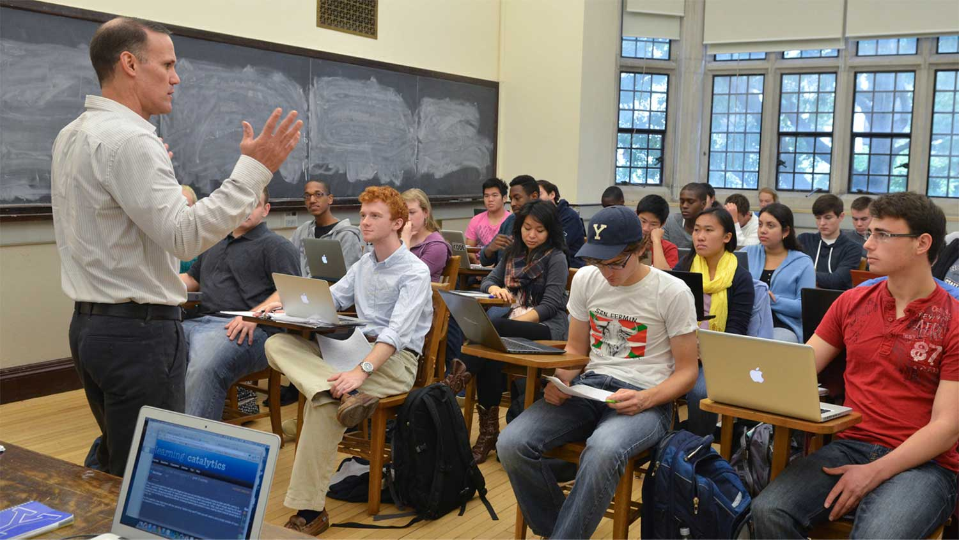
Preparing for
Go-Live
Workday@Yale

Slide 21
Preparing for Go-Live
The Controller has provided information to prepare business offices for Go-Live. Consult your business office for further details.
Highlights from the communication include:
Cutover dates, most of which are typical year-end dates, with a few exceptions
Encouragement to accelerate year-end work as much as possible to facilitate a smooth transition
A warning that any work started in Oracle and concluded in Workday may require additional effort
Notes:
During the next update on Workday we will begin to provide more specific information around pre-go-live planning. What we can tell you right now is that we’re thinking about what steps will need to be taken and we are developing a plan to assist you.
Accelerate year end-work as much as possible
Accurate transition certain activities will need to be done in a specific order, necessitating earlier deadlines than in the past
Any work completed now will be beneficision

Slide 22
How You Can Prepare
Begin cleanup activities normally reserved for June - in May
Clean up outstanding expense reports - process new ones quickly
Close inactive PO’s
Clean up labor suspense
Clear Deficit Balances
Clear deficit balances at the award level
Clear deficit balances greater than $25,000 or have approved plan to carry forward

Slide 23
How You Can Prepare
Share Information:
Create charging instruction cheat sheets
Make sure you and your staff attend training
Review the Business Process maps and videos (Workday@Yale website)
Check anything that will cross systems:
Run labor schedules through converter
1st weekly payroll will run July 3
Check “over the cap” labor
Check charging instructions for all Purchase Orders
Setup New Vendors for Graduation and Reunion events

Slide 24
Training
Workday@Yale

Slide 25
Training Assignments/Invitations
Training invitations went out the week of May 1:
Training assignments were based on an individual’s role:
For example, people with the “Cost Center Finance and Accounting Specialist” role were assigned to the “Creating and Approving Journal Entries” course
Course assignments are based on Workday role assignments. Consult the Role-to-Course Map spreadsheet for further information.
Staff are encouraged to contact their Lead Administrators for any questions related to their roles.

Slide 26
Range of Training Resources
Auditorium Sessions Chart of Accounts (COA)
Managing Expenses
Purchasing Goods and Services
Working with Suppliers
Training Options:
Auditorium (4)
Instructor-Led (7) Web-Based (3)
Quick Guides (29)
Training Guides (10)
Simulations (33)
Instructor-led Training
Asset Accounting
Cash Sale Deposits/Gift Setup Request
Creating and Approving Journal Entries
Entering and Maintaining Grant Budgets
Managing Commitments
Payroll Accounting
Training Begins on May 23
Notes:
For Auditorium Sessions, we expect to serve 5,400 users
For instructor-led trainings, we expect to serve an excess of 760 users

Slide 27
Support
You will have support!
Local Workday Gurus are embedded in your department
Workday.yale.edu provides easy access to quick guides, web-based training, and additional supporting documentation
The Finance Service Center (FSC) will support all finance questions
Heightened support will be provided from July through October
Notes:
Your first option for support will be your Local Workday Guru and training materials found on the web (e.g. Quick Guides, Web-based training, etc.)
YSS will be providing the ‘front-door’ for Finance support through their Finance Support Center (FSC)
Calls will be answered and addressed as quickly as possible and escalated as needed
Hyper-care support will be provided from July – October
This means if the call center is unable to answer a question, there will be a team of people ‘behind’ them to help get you the answer you need quickly
More specific details to follow

Slide 28
What’s Next
Workday@Yale

Slide 29
What’s Next
Please remind all staff members to:
Read the customized training plan they received on May 1, outlining optional auditorium sessions and necessary instructor-led trainings
Click the provided link to the TMS training website
Accept their invitation(s)

Slide 30
What’s Next
Become an ambassador of change
Familiarize yourself with your local Change Network participants
Do you know who your Change Partner is?
Do you know who your Local Workday Guru is?
End-User Training begins the week of May 22

Slide 31
Community Engagement
Attendance is encouraged at upcoming awareness and training sessions
Watch training videos posted on www.workday.yale.edu
Provide feedback and contact workday@yale.edu with any questions
Find more information at www.workday.yale.edu
Notes:
Encourage your co-workers to prepare for the transition! There are many ways to help us spread the word: encourage attendance and upcoming events, watch training videos, provide feedback, visit the website, etc.

Slide 32
Thank You
Workday@Yale

