Slide 1
Workday Concept #1: Employee Self Service
What is Employee Self Service?
Employee Self Service (ESS) is the functionality allowing employees to initiate actions such as:
Managing personal information
Updating benefits
Setting-up direct deposit
What is considered personal information?
Personal information is information related to your individual human resources and payroll elections (i.e., federal tax & direct deposit information, emergency contacts, benefit choices). Your supervisor will not be able to view certain information such as direct deposit information and benefits enrollment/pension/retirement information.
For additional information or questions about the Workday@Yale program, please visit the program website at http://Workday.Yale.edu/ or email us at Workday@Yale.edu.

Slide 2
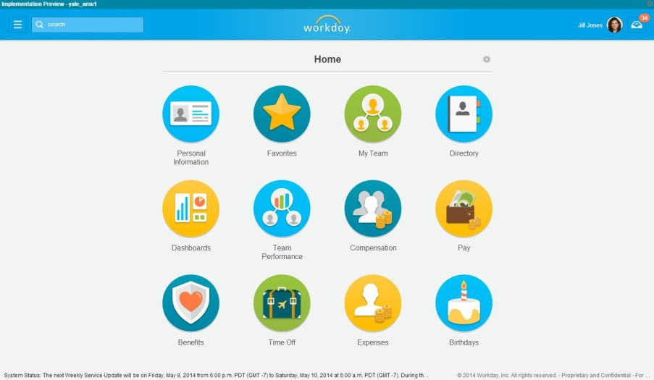
Workday Concept #1: Employee Self Service
Employee Self Service tasks are accessible through Workday’s Home page
For additional information or questions about the Workday@Yale program, please visit the program website at http://Workday.Yale.edu/ or email us at Workday@Yale.edu.

Slide 3
Workday Concept #2: Manager Self Service
Who is considered a Manager in Workday?
Anyone who has employees reporting to them will have the Workday role of “Manager”, which grants a certain level of access.
What can a Manager view and do in the system?
Manager Self Service provides supervisors with job, position, and compensation information for their direct reports, including access to numerous built-in reports to support HR-related analytics and decisions. Managers will not be able to view particular employee data such as direct deposit information and benefits enrollment/pension/retirement information.
For additional information or questions about the Workday@Yale program, please visit the program website at http://Workday.Yale.edu/ or email us at Workday@Yale.edu.

Slide 4
Workday Concept #2: Manager Self Service
Manager Self Service tasks are accessible through Workday’s “My Team” landing page
For additional information or questions about the Workday@Yale program, please visit the program website at http://Workday.Yale.edu/ or email us at Workday@Yale.edu.

Slide 5
Workday Concept #3: Supervisory Organizations
What is a Supervisory Organization?
Supervisory Organizations group employees into a management hierarchy and are required.
All faculty and staff are hired into a Supervisory Organization.
There is only one manager role per Supervisory Organization.
Supervisory Organizations are not used to manage finances and financial responsibilities; these are addressed through Cost Centers and other data elements.
How are Supervisory Organizations created?
Supervisory Organizations are established by:
Naming the organization
Designating the owner: the employee who supervises and manages the people in the organization
Assign members to the organization
For additional information or questions about the Workday@Yale program, please visit the program website at http://Workday.Yale.edu/ or email us at Workday@Yale.edu.

Slide 6
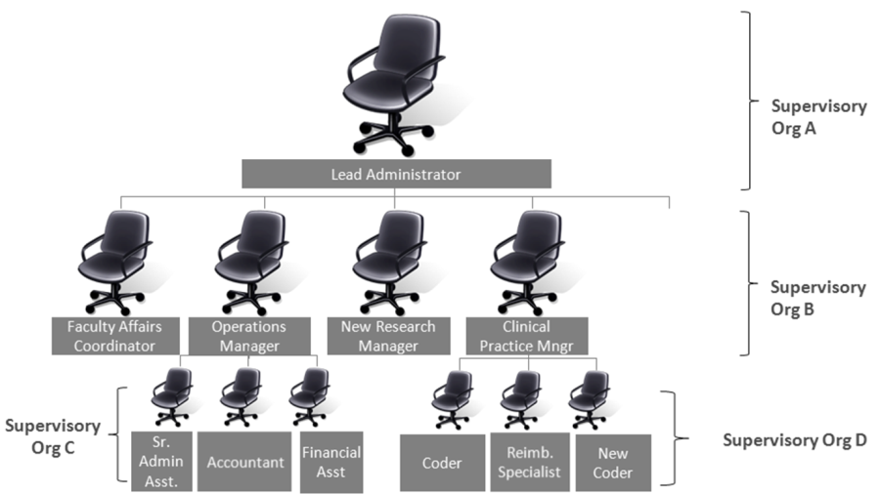
Workday Concept #3: Supervisory Organizations
Supervisory Organization Example
For additional information or questions about the Workday@Yale program, please visit the program website at http://Workday.Yale.edu/ or email us at Workday@Yale.edu.

Slide 7
Workday Concept #4: Roles
What is the purpose of roles?
Roles:
Determine what you can see and what you can do in Workday.
Provide individuals access to appropriate data within the assigned organizational structure.
Determine functional responsibilities and routing of actions in a business process
Who will be assigned a role?
All Workday users at Yale will inherit or be assigned a System Role.
Inherited roles are the default roles provided by Workday, including “Employee” and “Manager”.
Assigned roles include “HR Partner” or “Management Partner”.
For additional information or questions about the Workday@Yale program, please visit the program website at http://Workday.Yale.edu/ or email us at Workday@Yale.edu.

Slide 8
Workday Concept #4: Roles
Four Common Roles Include:
Workday Role | Description
Employee | General view of their own personal data, pay, and benefits
Manager | General view of own personal data and direct reports’ position and pay information, with the ability to kick off business processes (TBD) *Can also view their own Employee information
Partners (HR and FBO Business Partners, ITS, HRGs, Lead Administrators) | General view of personal data, pay, and benefits, client data, and often in the review or approval chain on business processes *Can also view their own Employee information
Administrators (Med School, Central, & Faculty, Research, Clinical Admin) | General view of personal data, pay, and benefits, organization data, and full data processes. May be a step in a business process *Can also view their own Employee information
For additional information or questions about the Workday@Yale program, please visit the program website at http://Workday.Yale.edu/ or email us at Workday@Yale.edu.

Slide 9
Workday Concept#5: Position Management
What is a staffing model?
Staffing in Workday is driven by staffing models—each supervisory organization is assigned a staffing model that determines how workers are hired into that supervisory organization
What are Workday’s staffing model options?
Position Management | Headcount Management | Job Management
A single position must be created for each new employee. One position is approved at a time. | A group is created with a number of allocated positions in which to hire employees. One headcount group is approved at a time. | No position quantity is defined. Increased flexibility, decreased control.
Yale will employ Position Management in most departments, extending the method to encompass faculty, post docs, staff and temporary hiring
For additional information or questions about the Workday@Yale program, please visit the program website at http://Workday.Yale.edu/ or email us at Workday@Yale.edu.

Slide 10
Workday Concept#5: Position Management
Position Management
Position Management allows a manager (or their designee) to:
Request that an open or budgeted position be routed for review and approval
Request a new position
Change a position
Reporting in this model will allow visibility of open positions
Funding or costing for positions will be maintained in Oracle Financials until July 2016
After 2016, this feature will be activated in Workday
Hire an employee in Workday
For additional information or questions about the Workday@Yale program, please visit the program website at http://Workday.Yale.edu/ or email us at Workday@Yale.edu.

Slide 11
Workday Concept#6: Configuration vs. Customization
Can Workday be customized?
No, unlike Yale’s legacy systems, Workday does not allow customization
Historically, Yale’s systems were customized to respond to the unique needs of each school or administrative unit. This adds a layer of complexity that must be addressed (typically through coding) whenever system changes are required. .
What does “Workday is configurable” mean?
Workday is designed to be configurable, offering Yale flexibility in designing the look and feel of the system.
This allows Yale to make modifications to the system that reflect the organization’s unique business needs, but prevents changes from being made that will disrupt the business in the future when software upgrades are required..
Because Workday is configurable, system updates are deployed in a fraction of the time and cost of traditional legacy ERP systems
For additional information or questions about the Workday@Yale program, please visit the program website at http://Workday.Yale.edu/ or email us at Workday@Yale.edu.

Slide 12
Workday Concept#6: Configuration vs. Customization
Benefits of Configuration vs. Customization
Did You Know…
Did You Know…
Configuration:
Is less costly to implement
Provides greater long-term value
Is less complex to maintain
Workday releases new functionality 2x annually, so all Workday users are on the same version of the system at the same time, promoting consistency and collaboration.
Clouds and Condos
While the floor plan in a condo cannot be customized, the interior design and room layouts can be configured to the tenant’s preferences.
Compare cloud computing to living in a condominium…
Rather than employing customization toolkits, Workday offers configurable frameworks that allow users to make modifications to the software to meet the organization’s specific and unique needs.
For additional information or questions about the Workday@Yale program, please visit the program website at http://Workday.Yale.edu/ or email us at Workday@Yale.edu.

Slide 13
Workday Concept#7: SaaS
What does “SaaS” mean?
Workday employs a Software as a Service (SaaS) solution where data is hosted centrally by a vendor.
SaaS enables software and data to be delivered to users over the Internet versus traditional ERP solutions that are hosted on premise.
Often referred to as a “cloud-based application”, there is no local installation of hardware or software required.
Will my data be secure in the cloud?
Workday delivers world-class infrastructure, policies and procedures to ensure data is protected.
Security threats and risks are mitigated through strong internal controls and a comprehensive security program.
Workday consistently passes rigorous third-party compliance audits, including multiple SAS70 Type II audits, and certifies to the U.S. Safe Harbor program for data privacy.
For additional information or questions about the Workday@Yale program, please visit the program website at http://Workday.Yale.edu/ or email us at Workday@Yale.edu.

Slide 14
Workday Concept#7: SaaS
Characteristics of SaaS
No Hardware/Software
Hardware/software is installed and maintained by Workday
Highly Configurable
Yale can modify the look and feel of the application by selecting configurable options.
Single Version
A single version of Workday is used for all customers. Yale will always be on the latest release.
For additional information or questions about the Workday@Yale program, please visit the program website at http://Workday.Yale.edu/ or email us at Workday@Yale.edu.

Slide 15
Workday Concept#8: Tenant
What does “tenant” mean?
A tenant is any application that requires its own secure computing environment. Each Workday customer has their own secure tenant that only they can access.
When Yale makes changes to the system through configuration, these changes will only be reflected in Yale’s tenant and will not be visible to other customers.
What is “multi-tenancy”?
Multi-tenancy, a key feature of Workday, enables all customers to experience the full spectrum of Workday functionality through one application server.
Each Workday customer’s tenant is logically isolated with their own data and configuration, but physically integrated on the same operating system.
Multi-tenancy allows for cost savings by consolidating IT resources without compromising individual tenants’ security.
For additional information or questions about the Workday@Yale program, please visit the program website at http://Workday.Yale.edu/ or email us at Workday@Yale.edu.

Slide 16
Workday Concept#8: Tenant
Benefits of Multi-Tenancy
Compare cloud computing to living in a condominium…
Faster Innovation
Stronger Community
Lighter Footprint
SaaS architecture allows Workday to make updates remotely and at the same time so no customer is left behind when updates are made to include new features.
With every customer on the same version of Workday, it creates a community where customers share knowledge, resources, and learning.
Workday’s centralized data centers reduce energy consumption and use computing resources more efficiently, helping Yale stay green.
Condominiums create a natural community for tenants, who often share outdoor community space or use a shared online portal to post questions about the apartment, buy/sell furniture, pay rent, etc.
Condominium buildings use less energy and cost less to heat/cool than a single occupancy unit as a result of centralizing and sharing these services.
When a building’s management provides services to all tenants, and as it improves services, all tenants benefit (i.e. air conditioning is repaired, parking lot is paved).
For additional information or questions about the Workday@Yale program, please visit the program website at http://Workday.Yale.edu/ or email us at Workday@Yale.edu.

Slide 17
Workday Concept#9: Integrations
Why are integrations from legacy systems so complex?
Traditional ERP applications did not consider the need for data-processing and communication with other systems. Today, achieving integrations from legacy systems is complex, due to:
Different systems
Disparate technologies
Required ongoing maintenance
Escalating costs
Will integrations with Workday be less complex?
Yes. To simplify integrations, Workday offers a variety of packaged integration tools:
Application Programming Interfaces (APIs): APIs specify how various software components interact. Workday offers comprehensive APIs to support all integrations to and from Workday
Integration Cloud Platform: Enables integrations to be built, deployed and managed in Workday’s Cloud
3. Integration Cloud Connect: Workday’s ecosystem of packaged integrations and connectors are managed in the Workday Cloud. This vendor-supported approach significantly shifts the cost, risk and burden of integrations from the customer to Workday.
For additional information or questions about the Workday@Yale program, please visit the program website at http://Workday.Yale.edu/ or email us at Workday@Yale.edu.

Slide 18
Workday Concept#9: Integrations
Workday’s Integration Cloud
For additional information or questions about the Workday@Yale program, please visit the program website at http://Workday.Yale.edu/ or email us at Workday@Yale.edu.

Slide 19
Workday Concept#10: Why Change Management?
What is Change Management?
Change Management (CM) is the process by which an organization prepares for and adapts to change.
CM encompasses an integrated approach to communications, engagement, and training.
Why do we need Change Management?
Workday will impact everyone in the Yale Community and change the way we do work. The transition to Workday will not only replace obsolete systems, but will give Yale the opportunity to reimagine our business process environment.
Workday’s twice yearly release schedule and the Program’s rapid pace of change requires effective change management and a network of strong leaders at every level to help create a culture of change.
The Workday@Yale CM team works to engage the Yale Community and identify the most effective means of increasing organization-wide commitment.
For additional information or questions about the Workday@Yale program, please visit the program website at http://Workday.Yale.edu/ or email us at Workday@Yale.edu.

Slide 20
Workday Concept#10: Why Change Management?
Workday@Yale CM Approach
Food for Thought
“
Existing models of higher education are broken; universities must embrace rapid change or have obsolescence visited upon them; in today’s market, technology drives this and nothing can stop it. However, our study determined that technology does not have a free hand in driving change. Change is driven (and held back) by people.”
Observatory for Borderless Higher Education’s 2020: Horizon Report, Sept. 2013
For additional information or questions about the Workday@Yale program, please visit the program website at http://Workday.Yale.edu/ or email us at Workday@Yale.edu.

