Slide 1
Workday@Yale Executive Update
February 19, 2015

Slide 2
Introduction Workday@Yale Overview & Timeline

Slide 3
Yale and Other Peers have Selected Workday
Important to Understand, for Yale …
Very Large Project:
Over 350 staff involved
Attempting to fund and staff largely within base budgets
Multi-year effort:
Began evaluation in 2012
HCM/Payroll deployment 2015
Financials deployment 2016-2017
Technically challenging
Significant change management effort
A huge opportunity !
University of Rochester
University of Chicago
Notes:
Yale’s current systems are outdated, complex to support, and no longer meet the University’s needs and compliance requirements
The University needs a flexible, configurable system with the ability to support the increasingly global campus
Workday will result in both operating cost savings and non-financial benefits:
Workday is less costly to support and offers enhanced, innovative functionality
There is no local installation of hardware or software required
Workday is recognized for its continuous innovation, releasing updates twice a year to provide new functionality
Updates to the system are implemented automatically, so no coding or IT support is required

Slide 4
No Choice about replacing system, but we’re aiming for better than status quo!
Workday@Yale will support Yale’s mission with excellent administrative services that mirror Yale’s excellence in teaching, research and practice, making it easier for faculty, students and staff to get their work done.
Developed with broad community engagement, Workday@Yale will be defined by easy to use systems that lower the administrative burden for all, deliver trusted information and reduce overall costs.
Make it easier to get work done and harder to make mistakes
Simplify and standardize administrative and other related business processes
Establish and accurate, consistent and timely reporting environment
Minimize the administrative burden for faculty and administrators
Lower operating costs and improved administrative services

Slide 5
Workday@Yale Implementation Timeline
Employee self-service
Manager workflow
Compensation & Benefits
Payroll
Faculty “Lifecycle”: Appointments & Appointment History, Unified Academic Reporting
Expense Management
Procurement
Supplier Accounts & Contracts
Business Assets
Sponsored Awards Management
Endowment and Gift Accounting
Customer Accounts
Banking & Settlement
Accounting & Reporting
Release 1:
HR / Payroll / Academic Information
Release 4:
Financials
2015
2016
Jan
Mar
May
Jul
Sep
Nov
Jan
Mar
May
Jul
July
Release 3:
Chart of Accounts Change
New Financial Data Model
Additional Releases-FY17 and beyond*
time tracking
recruiting & staffing
student systems
other academic and financial enhancements
Release 2*:
Merit
Benefits Enhancements
*Exact timing and content are TBD

Slide 6
What’s Changing?

Slide 7
Activities in Workday
Employees will be able to:
Edit personal contact information
Maintain direct deposit
Edit emergency contacts
Request Leave of Absence
Print W-2’s
and much more…
Managers will be able to:
Initiate a job requisition
Initiate hiring a new employee
Request a one-time payment
View HR reports
View department compensation reports
and much more…
Departments will be able to:
Track and maintain academic ranks eligible for appointment
Capture faculty data via report for a snapshot in time, period of time, or future period
Access current, historical, and future faculty and post-doc appointments within any department across the university
and much more…
Employee Self-Service
Manager Self-Service
Academic Processes

Slide 8
Workday Software Enables Many Desired Features
1
Access to Information:
Secure and easy access to your own data, on any device
Dashboards, Reports and “drill down” capability
2
Improved Workflow
Workday’s automated workflow routes tasks to the appropriate user, enabling smoother, more efficient transitions between tasks and transparency regarding status
3
Self-Service
Yale faculty and staff will be able to initiate actions such as updating their benefits
Managers can access to relevant information for their organization via dashboards, reports & workflow
4
Increased Visibility
Workday will provide Yale with a unified system of record for employees, bringing information for faculty, managers, clinicians, researchers, professionals and all other staff at Yale into one place
5
Informed Decision-Making
Integrated HR/Payroll and Finance systems will allow Yale to produce more accurate reporting
Managers and business offices will be able to view key job-related information about their organization to support improved decision-making.
Notes:
Automated workflow: essentially “hands off” tasks requiring action to the correct individual

Slide 9
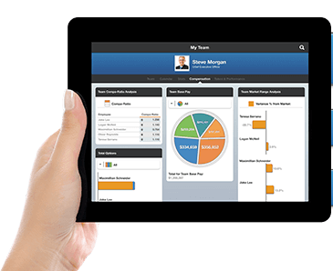
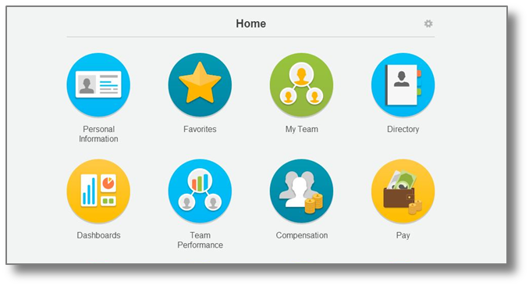
What Can Managers Expect?
Managers can expect:
Quick and easy access to organizational information
Managers will be able to view key information about their staff members, such as:
Position and Compensation information
Change Management Issue
The system will ultimately equip managers to:
Make budgetary decisions
Assist with talent development
Notes:
Through Manager Self Service, Managers will be able to:
Access real-time data
Generate and export reports
Initiate HR transactional data, such as promotions and transfers
Request compensation changes and make changes to an employee’s job information (i.e. pay rate type, work location, etc.)

Slide 10
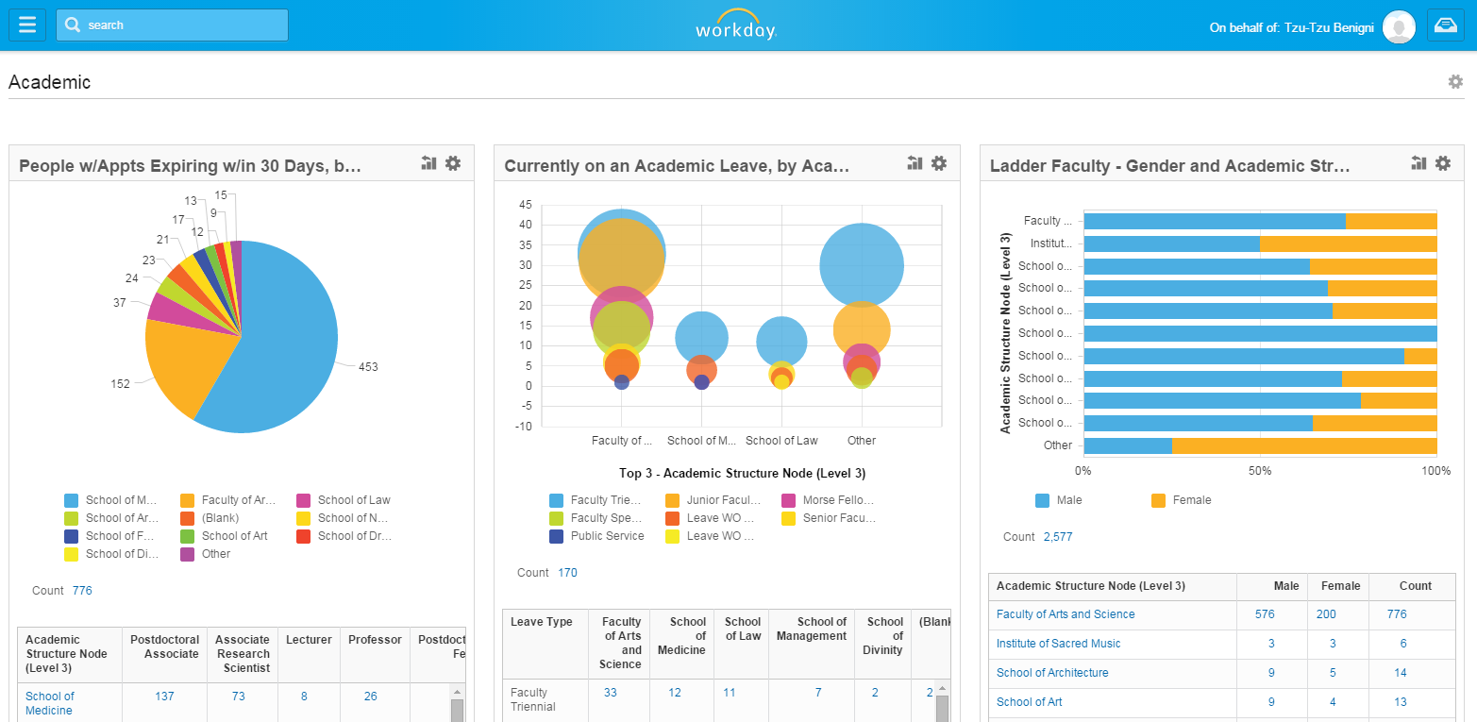
What Can Academic Leaders expect?
Ability to succinctly capture academic data through Workday dashboards
One system of record for academic appointment information, examples include:
Workday Appointment Reporting provides insight into upcoming expiring appointments, tenure review or reappointments currently in process
Immediate access to current, historical, or future faculty and post docs appointments within any department across the university
Named Professorships: primary and consolidated source of information for named professorships, financials and their corresponding academic appointments in Workday
Future enhancements enabled by our Design Partnership with Workday to include: academic administration, committees, sabbatical eligibility, academic specialties, professional affiliations and the development of a comprehensive faculty profile

Slide 11
What Systems will be Affected with Release 1?
Activity | System Used Today | System Used After Release 1
Manage Academic Appointments & Promotions | Paper Submission / BMS | Workday
View and Maintain Benefit Information (i.e., Medical; Dental; Vision; Insurance) | My Benefits (Hewitt) | Workday
Submit and Review Benefit Claims (i.e., Healthcare and Child/Dependent Care, Flexible Spending, Commuter, Tuition) | Your Spending Account (via My Benefits) | Your Spending Account (via Workday)
View and Maintain Direct Deposit Information | My Pay & Info (Oracle) | Workday
View Payslip | My Pay & Info (Oracle) | Workday
Change Job (i.e., Promotion) | Paper Submission / Oracle | Workday
View and Maintain Personal Information (i.e., Preferred Name, Home Phone, Emergency Contacts, Yale Alert Contact) | My Pay & Info (Oracle) | Workday
View and Update W-4 (Federal Only) | My Pay & Info (Oracle) | Workday
View and Update W-4 (State) | Paper Submission | No Change
View and Maintain Retirement Savings | My Benefits (Hewitt) | TIAA-CREF website (Employees will manage both Vanguard and TIAA-CREF investments on the TIAA-CREF website)
Conduct Recruiting and Hiring Activities (i.e., Create Requisition) | STARS (IBM Kenexa Brass Ring) | No Change
Version 8: 2/18/2015
*Please note, this is a living document and is updated on a continuous basis.

Slide 12
Community Engagement & Training Approach

Slide 13
Not a repeat of the Oracle “Project X” experience
Typical Large ITS Program Structure
Program Leadership
Process Work-Stream Teams
Staffed by Subject Matter Experts Largely from Central Process Organizations
Schools
Units
Departments
End-Users
Center-Led Change Management & Training
Yale ITS
Systems Integrator: Deloitte Consulting
Vendor Partner: Workday

Slide 14
Not a repeat of the Oracle “Project X” experience
Workday@Yale is truly being developed with broad community engagement … Service Groups and Change Partner Network are important additions to how we approach these large scale projects
Program Leadership
Feedback Mechanisms
Process Work-Stream Teams
Service Groups
Schools
Units
Departments
End-Users
Change Partner Network
Staffed Primarily with School/Department Staff
Yale ITS
Systems Integrator: Deloitte Consulting
Assisted by Center’s Change Management Team
Vendor Partner: Workday

Slide 15
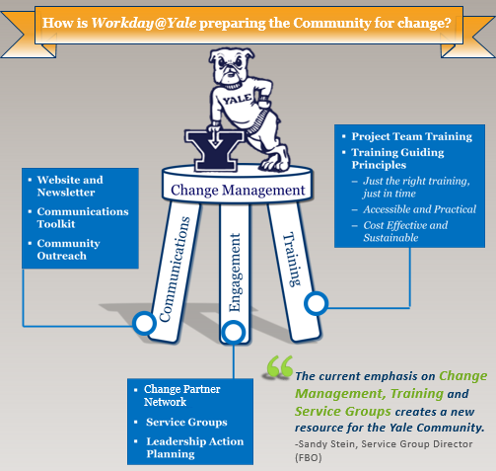
Change Management Helps Mitigate Change Impact
Notes:
We will train you – heaviest training for those that will use Workday the most (HR, business offices) and for those who will support the community (ESC, Help Desk, YSS, Change Partners)
Training: videos, quick guides, in-person, help text, notifications, maybe webinars, etc.

Slide 16
Blended Learning Approach Accelerates User Adoption
Workday@Yale training utilizes Workday role assignments to create a learning experience that is tailored to faculty and staff’s future use of Workday. This personalized training approach will be supported by the following elements of learning:
Communications & Stakeholder Engagement
Utilize a variety of communication methods to build awareness and establish a baseline level of Workday knowledge
Just in Time Training
Train the right people with the right resources at the right time
Elements of Learning
Formal Support Network
Leverage the Employee Service Center and additional support networks to provide a direct support link across the Yale Community
Accessible Training Materials
Utilize diverse methods, tools, and platforms to ensure training material is easily accessible to all faculty and staff

Slide 17
Workday@Yale Training Deployment Timeline
The training deployment timeline is prioritized based on the order in which Yale audiences should be educated for “Day 1” of go-live in July. Core users such as HRGs, support desks, Ops Managers, and Lead Administrators will be prepared to support the training for the larger Manager and Employee groups.
Go Live
June/July 2015:
Training to Support Self Service
(Workday Overview and Navigation)
Employees (All ESS users)
Managers (Rollout of MSS will be localized; identification of training population will be done with LAs)
April/May/June 2015:
Begin Workday Training (Workday Navigation, Workday Business Processes, Workday Support Model)
Lead Administrators & Operations Managers (~170 users)
HR Generalists & Other Staff & Academic Support Roles (~450 users)
Employee Service Center & Other Support Teams (~75 users)
March 2015:
User Acceptance Testing (UAT)
Workday@Yale Functional Team (~50 users)

Slide 18
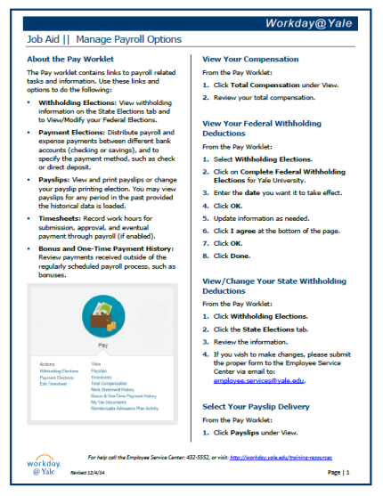
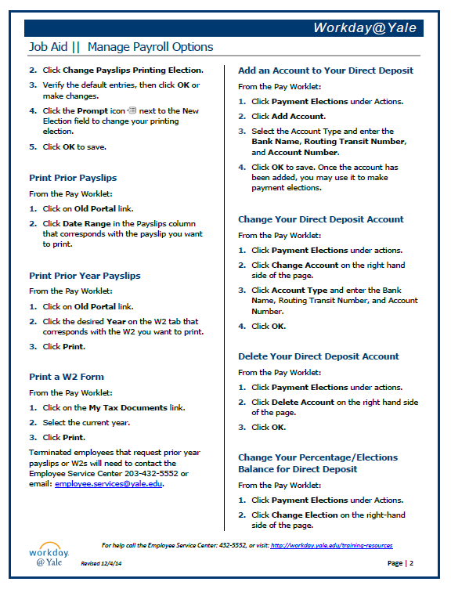
Workday@Yale Employee Self Service Training Materials
Overview of Employee Self Service (ESS) Curriculum
Sample Job Aids
Web Based Training
Workday@Yale Overview
ESS for Faculty & Staff
Job Aids
Getting Started: Using Your Navigation Tools
Getting Started: Using Your Inbox
Modifying Your Personal Information
Managing Your Benefits
Managing Your Payroll Options
Requesting a Leave of Absence
Accessing Workday via Mobile Devices
Employee Onboarding Checklist

Slide 19
Service Groups
Each Service Group consists of 10 Representatives of the University Community from all levels of the organization
Purpose
Workforce Management
Accuracy of Unit Financial Statements
Information Delivery
Faculty Recruitment, Appointments and Promotions
Position & Compensation Management
Student & Temporary Hiring & Life Cycle Management
Getting Started at Yale (Onboarding)
Purchasing Goods & Services (External & Internal/ISPs)
Gift & Endowment Stewardship
Sponsored Awards Management
Hiring Staff
Unit Financial Management
Arranging Travel, Business & Special Events (Expense Management)
Improve overall satisfaction with services that support our work every day
Champion new processes and define value and service level expectations – from the user point of view
Identify the end to end service including policy, procedure and the integration and overlap of processes and systems
Serve as key champions of change for business processes and service changes around and within Workday
Notes:
The role of Service Groups is to provide meaningful feedback on business process design and represent the user in the development of other systems that will support Workday.
Service Groups represent the larger range of processes that intersect with Workday to help clarify service expectations and improve end-to-end service delivery
Service Group Activities: Evaluate if services and business processes meet the strategic objectives of Workday
Determine if there is measurable improvement in how the new processes will work

Slide 20
Extensive Opportunities for Yale Community Engagement…
Service Groups
Volunteer or nominate a colleague to be a member of a Service Group: http://volunteer-nominate.yale.edu/
Monthly Newsletter
Subscribe to the Workday@Yale newsletter at https://messages.yale.edu/Subscribe/List/ITS
Feedback
Submit feedback to the Program Team at http://workday.yale.edu/workdayyale-commentsfeedback
Engagement Mechanisms
Website
Browse the Workday@Yale website at http://workday.yale.edu
Communications Toolkit
Browse the resources available in the Workday@Yale Communications Toolkit: http://workday.yale.edu/training-resources/communications-toolkit
Email
Contact the Program Team at Workday@Yale.edu

Slide 21
Questions
?

